Slide 1

WHAT MAKES A HIT SONG?
A Spotify Analysis
Lance Te (45581819)
Ava Gardiner (46410961)
Darcey Burch (45421706)
Thomas Mansfield (45381127)

Slide 2
| The Context
Mainstream record labels dominate 68% of the music industry.
Yet these songs account for less than 1% for the music produced each year.
Streaming services like Spotify have made uncovering new musical tastes easier.
Vast amounts of data have been made available.
The Question: What does a song need to become a hit?
Notes:
Context + problem

Slide 3


| The Problem
To determine the key factors that make a hit song. In order to address the core question, we will investigate the following questions:
What attributes should a song have to be successful?
Is it possible for a song that sounds sadder or angry to become a hit?
Does the artist influence the popularity of a song?
Does the song need to be in a certain genre to be a hit?
Does a collaboration gain more popularity to a song that has a single artist?
Notes:
Context + problem

Slide 4


| Data: Retrieval
MY APP
JUPYTER
FEATURES
Popularity
Artist
Track
Year
Danceability
Energy
Key
Loudness
Mode
Speechiness
Acousticness
Instrumentalness
Liveness
Valence
Tempo
Duration
Time Signature

Slide 5
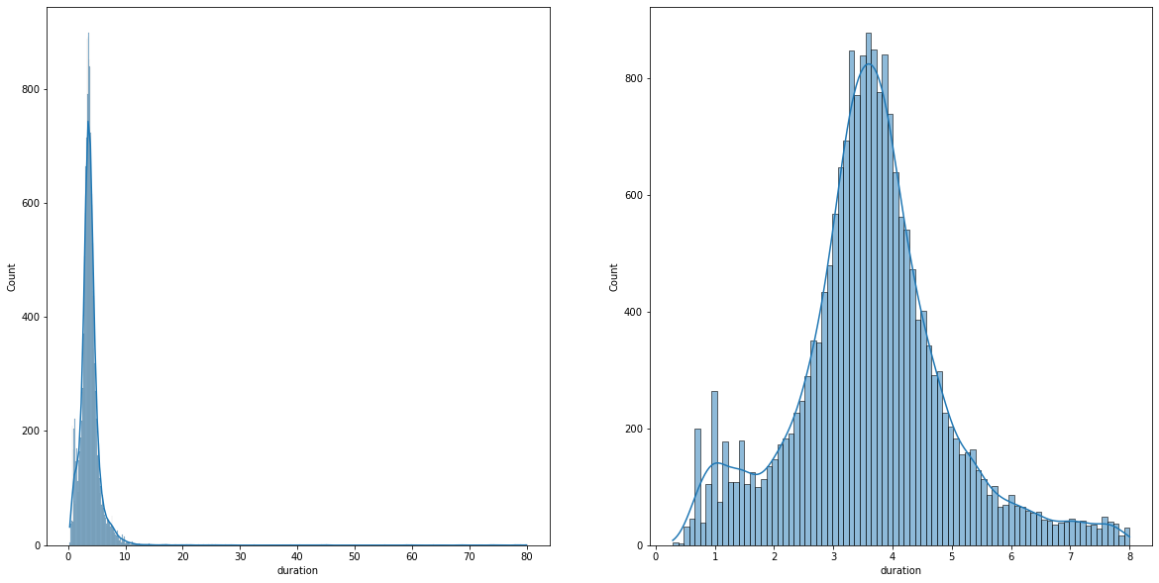
| Data: Cleaning
Duration
Original
20,517 x 18
Used an 8-minute cut-off
Removed duplicate IDs
Removed null values
20,517 x 18
Removed songs with zero tempo
Removed songs longer than 8 minutes
19,995 x 18

Slide 6
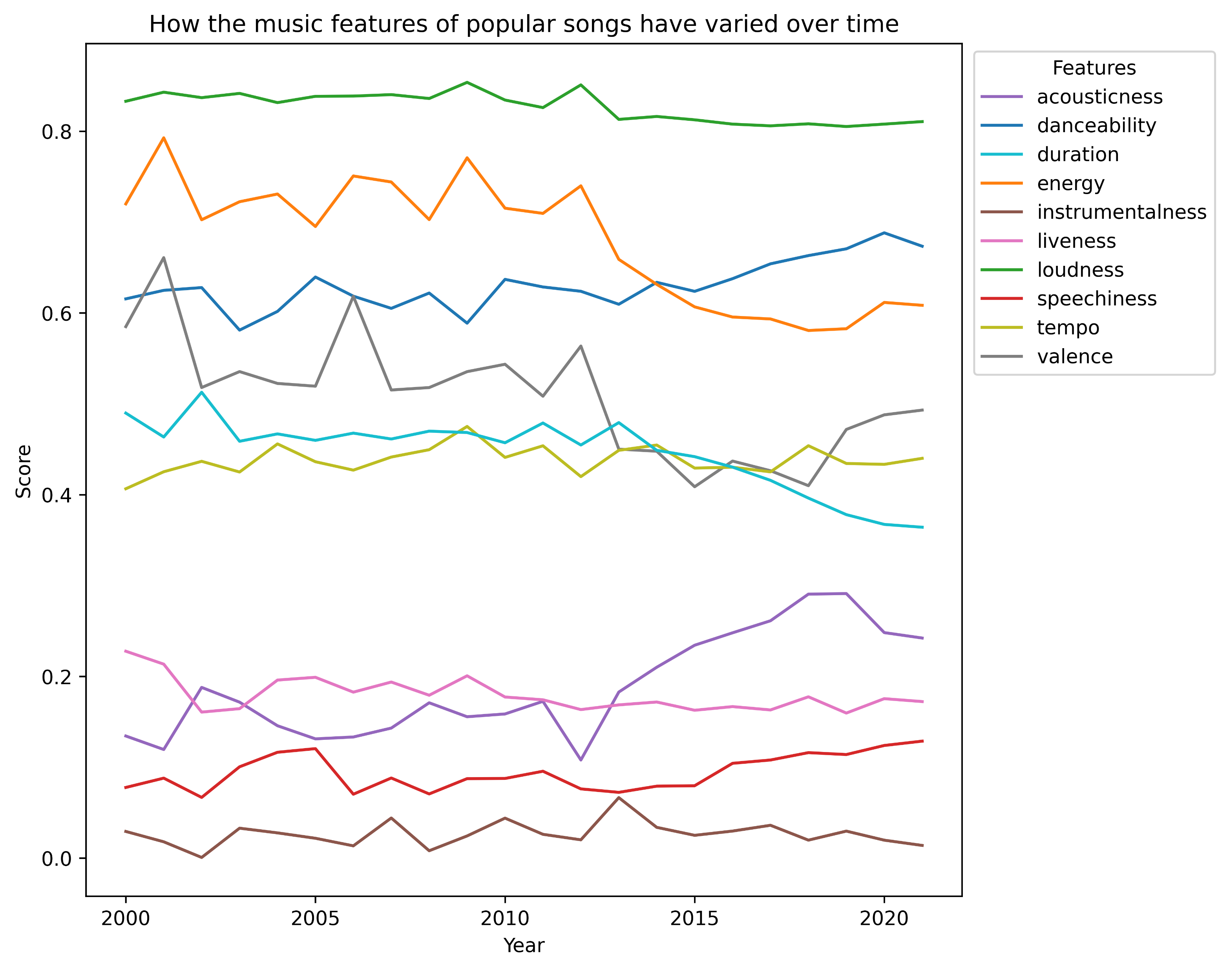
| Exploration
01
Songs continue to be very loud since 2000
02
Songs continue to be very loud since 2000
03
Songs continue to be very loud since 2000

Slide 7
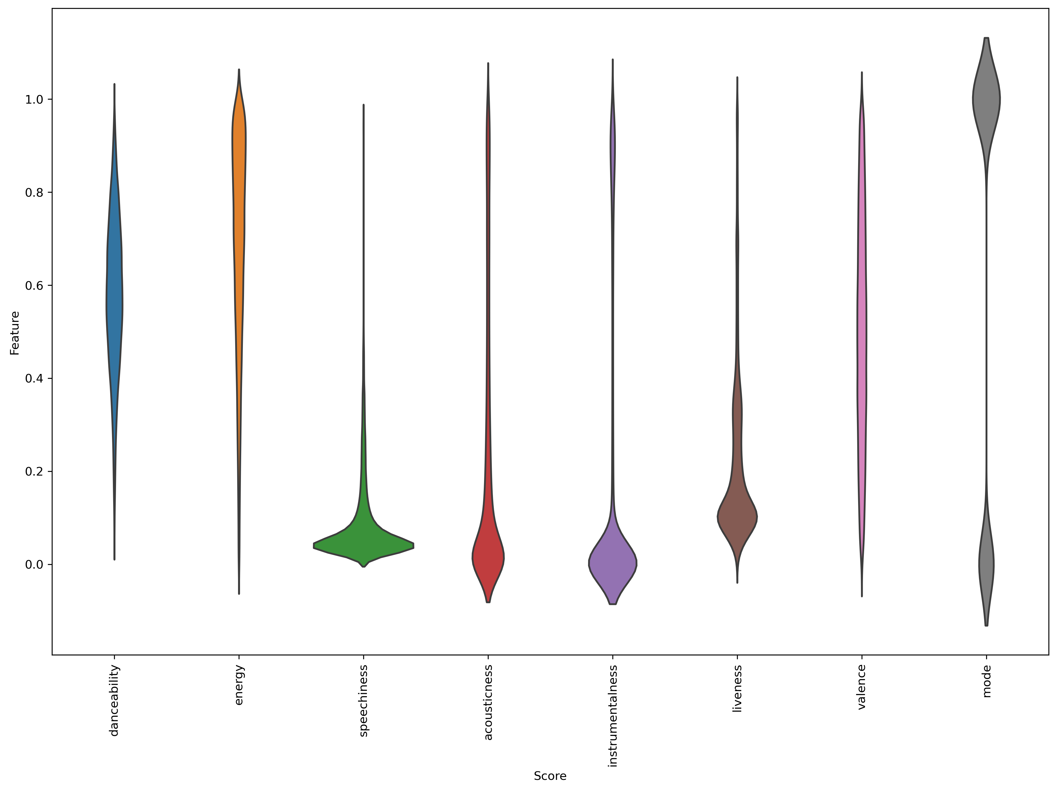
| Exploration
01
Songs continue to be very loud since 2000
02
Songs continue to be very loud since 2000
03
Songs continue to be very loud since 2000

Slide 8
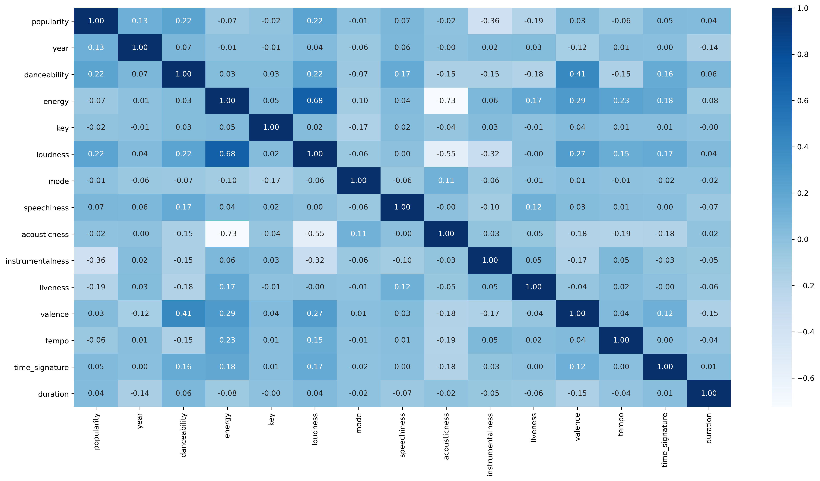
| Exploration
01
Songs continue to be very loud since 2000
02
Songs continue to be very loud since 2000
03
Songs continue to be very loud since 2000

Slide 9
| Our Method
REMOVE NULLS AND OUTLIERS
SELECT THE BEST OVERALL MODEL
Retrieve
Model
Tuning
Clean
Select
RETRIEVE DATA FROM SPOTIFY
FIT THE DATA TO A RANGE OF MODELS
FINE TUNE THE MODEL PARAMETERS

Slide 10
| Our Models
Supervised Learning
Neural
Network
Used when the output variable takes continuous values
1
2
Used when the output variable takes discrete / categorical values
Regression
Classification
Linear
Decision
Tree
Random
Forest
+
KNN
GNB
Random
Forest

Slide 11
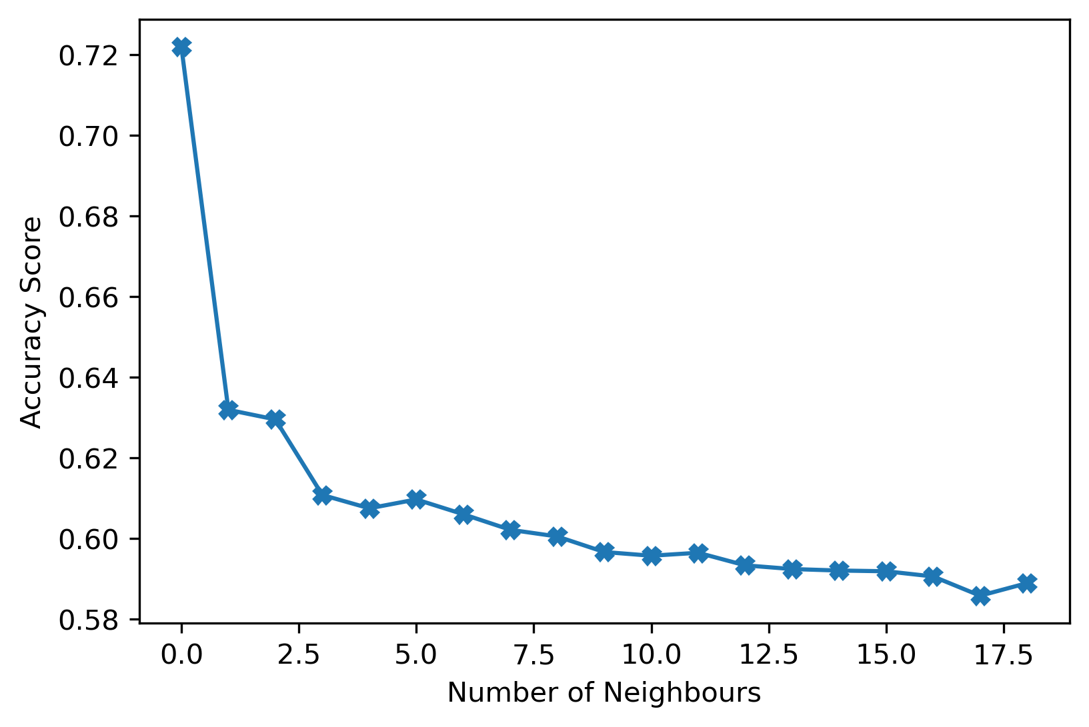
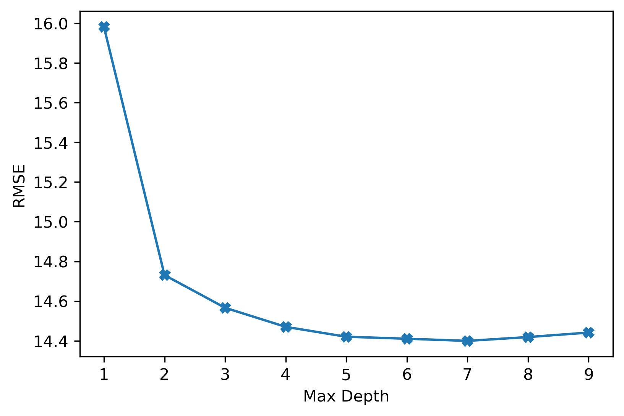
| Hyper Tuning
K-Nearest Neighbours
Random Forest Regression

Slide 12
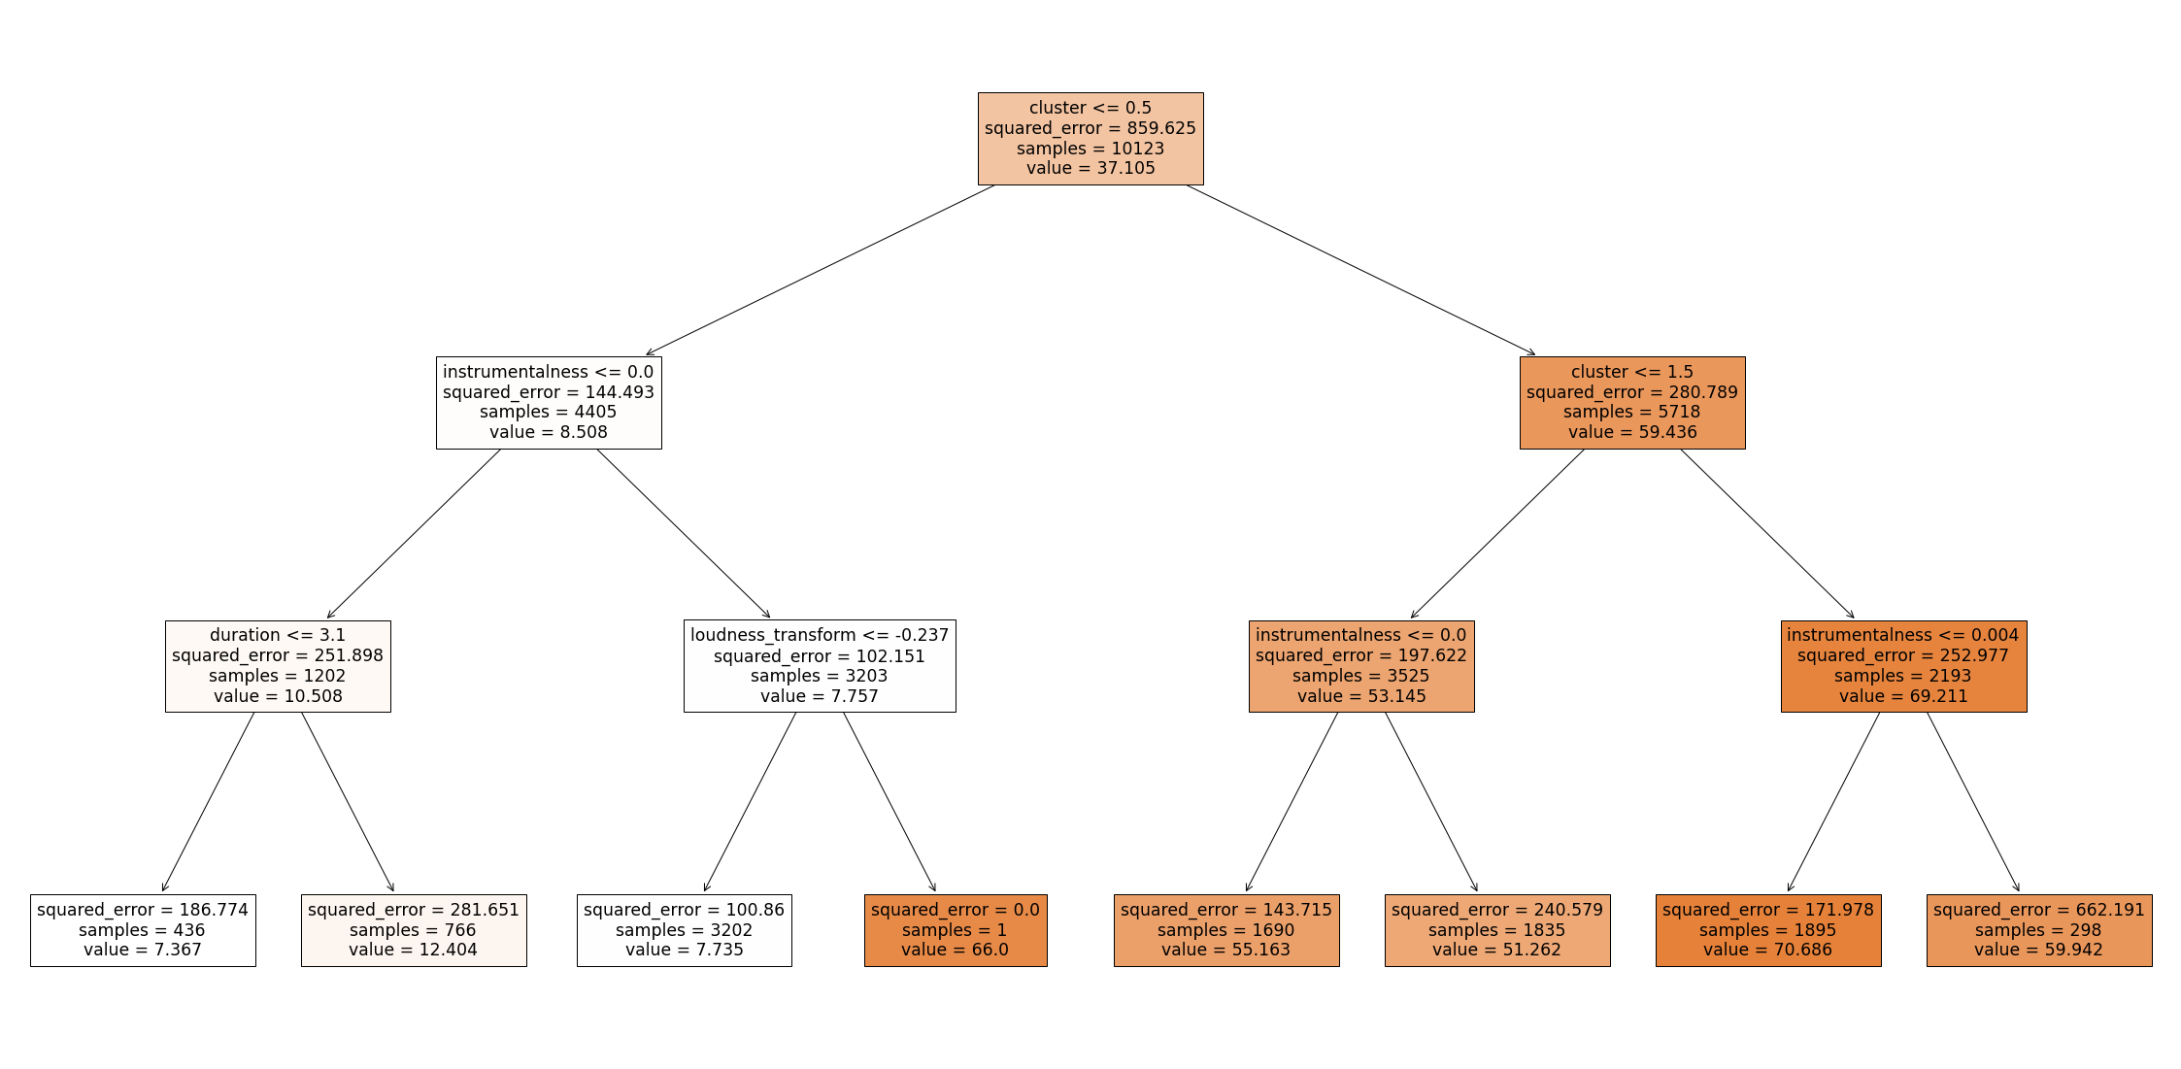
| Final Tree

Slide 13
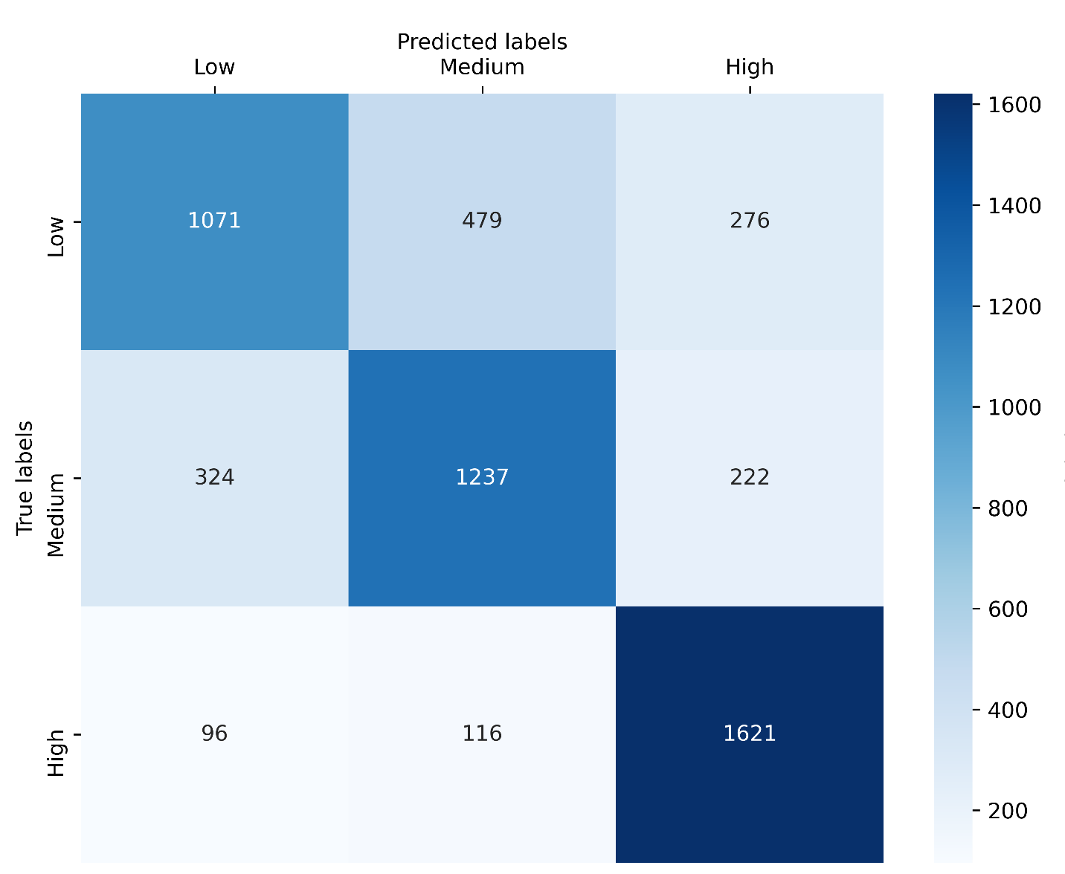
| Our Results
Regression: R-squared
Classification: Accuracy
Confusion Matrix: KNN
64%
72%
60%
61%
53%
34%
25%
27%
Linear
Decision
Tree
Random
Forest
Combined
Neural
Network
GNB
Random
Forest
KNN

Slide 14


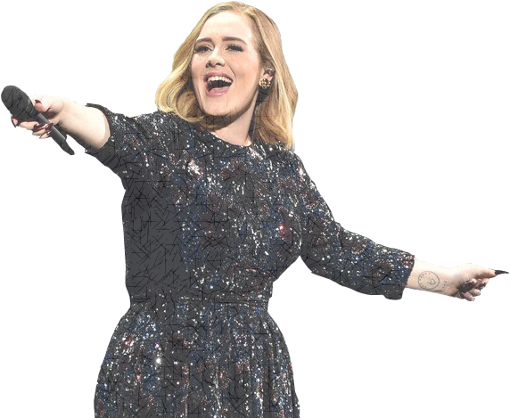
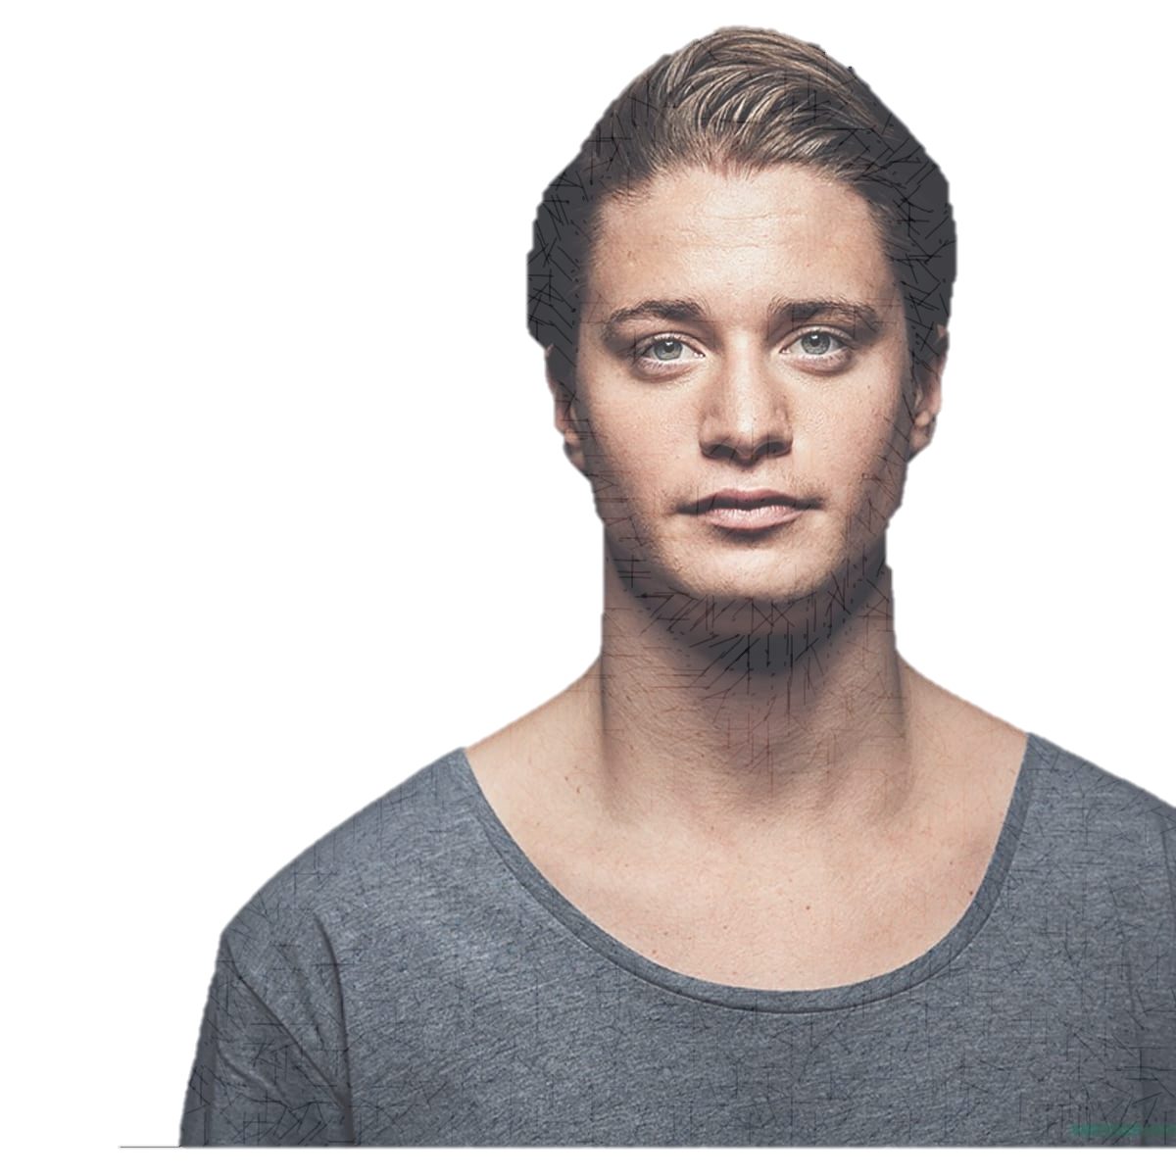
| Conclusion
Every popular musician has their unique musical style.
Ed Sheeran, is a huge fan of acoustic guitar
Drake has perfected the art of rapping
Adele can hit exceptionally high notes in her pop ballads
Kygo, whose DJ performance is filled with EDM enchantment.

Slide 15
This brings us to a question that many aspiring and successful musicians want to know the answer to…
|
WHAT MAKES A SONG UNIQUE, AND WHAT QUALITIES SHOULD A SONG HAVE IN ORDER TO BECOME A HIT?.
In other words, can we really predict what makes a song a hit?
→
TO ADDRESS THIS QUESTION

Slide 16
|
We Relied On A Variety Of Musical Features:
Popularity
Artist
Track
Year
Danceability
Energy
Key
Loudness
Mode
Speechiness
Acousticness
Instrumentalness
Liveness
Valence
Tempo
Duration
Time Signature
Retrieved from Spotify's API to assist us in predicting whether or not a song will be a hit.
Despite the fact that our results appear to be
OPTIMISTIC
OUR RESULTS demonstrates that there is no magic formula yet that can help us predict a song being a hit before it is released.

Slide 17
|
When we first started working on this project,
We all had our own ideas about what qualities could make a hit song.
HOWEVER,
Our analysis of the Spotify data has yielded models with weak predictive capabilities.
This illustrates how difficult it is to predict something as subjective as music, since other factors contribute to a hit song:
One factor is the assumption that a song can become enormously popular as a consequence of advertising.
Another factor to consider is radio airplay.

Slide 18
|
Even though our predictive model does not fully answer our question,
Music producers and musicians can still apply our model to better understand their audiences and create songs that their fans will enjoy hearing.
Artists can better understand what lyrics to write and tailor the message of their songs to what their fan base would enjoy hearing.
Audio engineers can collaborate with artists to improve inherent musical aspects in order to make a song more popular, catchy, and unforgettable.

Slide 19
| Next Steps
Including data from other platforms, such as TikTok and YouTube. Is it true that these platforms promote song popularity? For example, is a specific type of song being utilised to perform a trendy TikTok dance?
How much radio airplay does a song receive? Does this have an impact on its popularity?
Is there a difference in the popularity of a song with a featured artist vs a song without a featured artist?
How popular is the artist? Is there a large social media following for that particular artist?
When is the best time to release a song? Is it critical to release a song at the right time in order for it to be successful?
Whether an artist is signed to a record label, and if so, which one?

Slide 20
|
We can additionally divide POPULARITY into subcategories based on:
Region
Demographics
Which device is the music streaming on?
Number of shared Spotify accounts

